Slide 1
Flood Mapping and Impact Assessment
SES 598 (Cloud Based Remote Sensing) Final Project
Sarwan Shah
Instructor: Jiwei Li

Slide 2
Motivation
Climate Change is a statistical fact and has led to an increase in the frequency of extreme weather events that have the potential to cause flooding.
During the Monsoon of 2022 Pakistan (my home country) witnessed devastating floods that submerged one-third of the region of Sindh under water.
Important to be able to quickly access the scale and extent of such damage.
This project demonstrates how this can be realized via remote sensing.

Slide 3
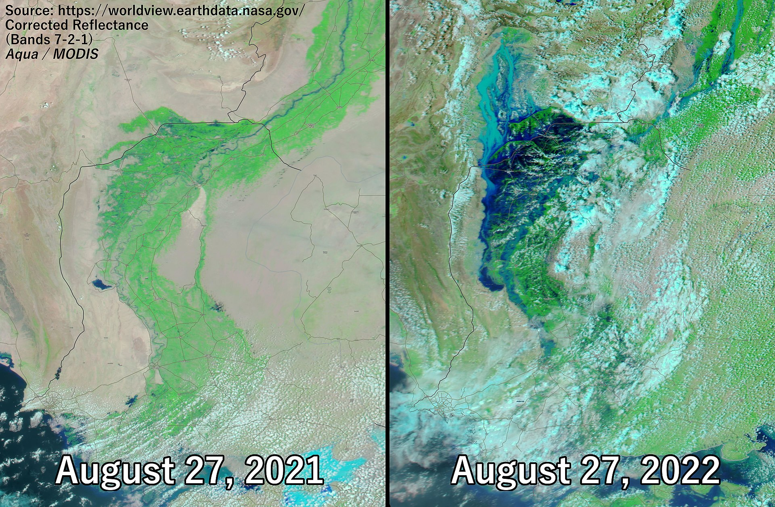
Motivation
Climate Change is a statistical fact and has led to an increase in the frequency of extreme weather events that have the potential to cause flooding.
During the Monsoon of 2023 Pakistan (my home country) witnessed devastating floods that submerged one-third of the region of Sindh under water.
Important to be able to quickly access the scale and extent of such damage.
This project demonstrates how this can be realized via remote sensing.

Slide 4
Solution Overview
A Google Earth Engine based application that can dynamically map floods across the globe based on user feed parameters.
These parameters are primarily:
Country
State
A ‘Before’ time-window that is representative of the state of the region before the flooding event
An ‘After’ time-window that is representative of the state of the region after the flooding event
Additionally, the user can also fine-tune thresholds concerning:
Flood detection threshold
Noise removal threshold
Computation parameters (for controlling trade-off between speed and memory)
Moreover, the application provides visualization and statistical assessment of the affect of flooding event on urban and rural (crop land) populations/regions.

Slide 5
Solution Demo
Mapping the 2022 Pakistan Floods
Focus: the state of Sindh
Before Flood Window: May 2022 – July 2022 (Pre-Monsoon)
After Flood Window: July 2022 – September 2022 (Monsoon)
Peak Flood: August 2022

Slide 6
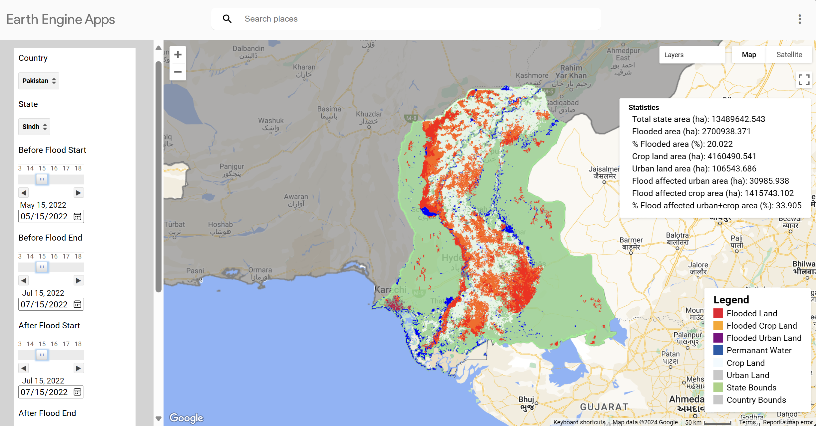
Solution Demo
Mapping the 2022 Pakistan Floods
Focus: the state of Sindh
Before Flood Window: May 2023 – July 2023 (Pre-Monsoon)
After Flood Window: July 2023 – September 2023 (Monsoon)
Peak Flood: August 2023

Slide 7
Motivation
Climate Change is a statistical fact and has led to an increase in the frequency of extreme weather events that have the potential to cause flooding.
During the Monsoon of 2023 Pakistan (my home country) witnessed devastating floods that submerged one-third of the region of Sindh under water.
Important to be able to quickly access the scale and extent of such damage.
This project demonstrates how this can be realized via remote sensing.

Slide 8
Solution Demo
Mapping the 2024 Dubai Floods? An Attempt
Focus: the state of Sindh
Before Flood Window: July 2023
After Flood Window: August 2023
Peak Flood: August 2023

Slide 9
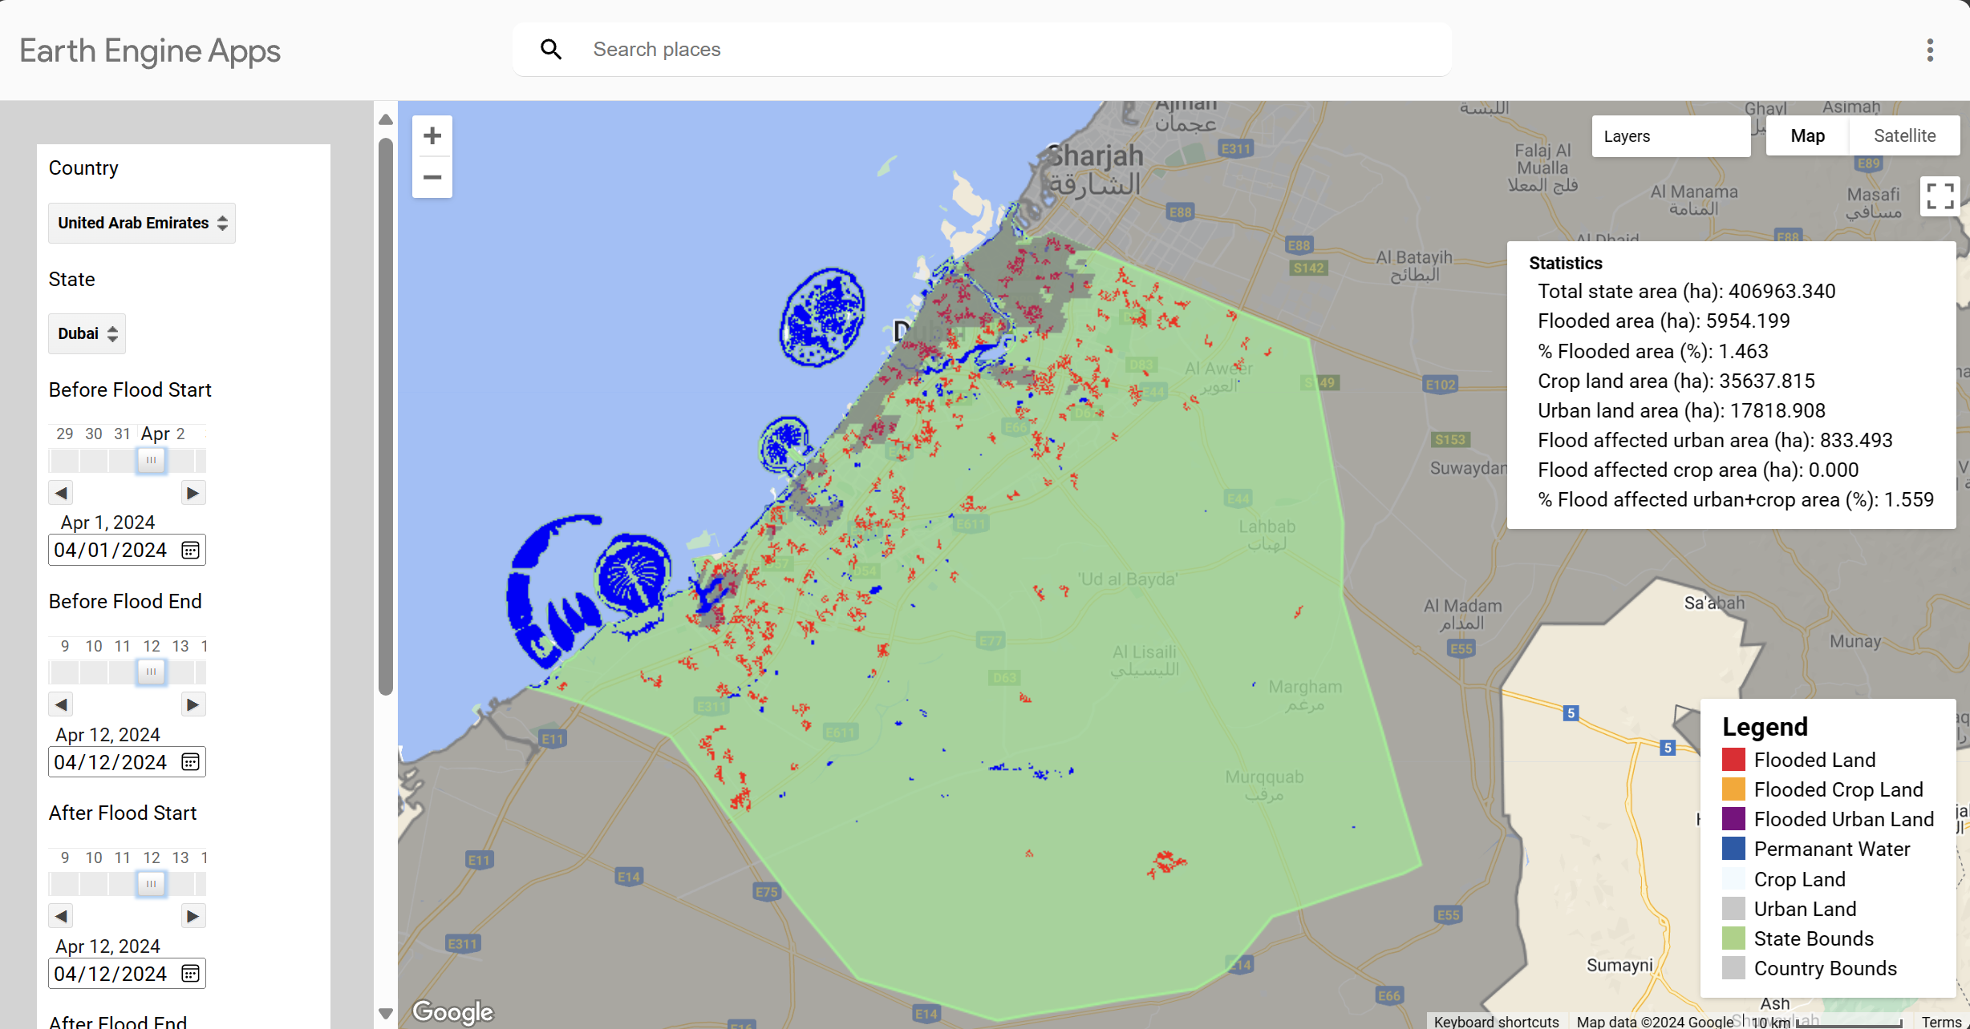
Solution Demo
Mapping the 2024 Dubai Floods? An Attempt
Focus: the state of Sindh
Before Flood Window: July 2023
After Flood Window: August 2023
Peak Flood: August 2023

Slide 10
Solution Details
Sentinel 1 used to capture flood data using C-band synthetic aperture radar (SAR) sensor.
Work during day & night.
Microwave based => Penetrates clouds
Spatial Resolution: 10m
Temporal Resolution: 6 – 14 days (2017 onwards)
Products: Single-Look Complex (for Inferrometry) & Ground Range Detected (GRD)
Radar-based vs Optical Based
The sensor captures signals in 4 different polarizations:
Vertical Vertical (VV), Vertical Horizontal (VH), HV, HH
VV most suited for flood detection: penetration through vegetation, reduced signal attenuation, strong back-scatter from water bodies

Slide 11
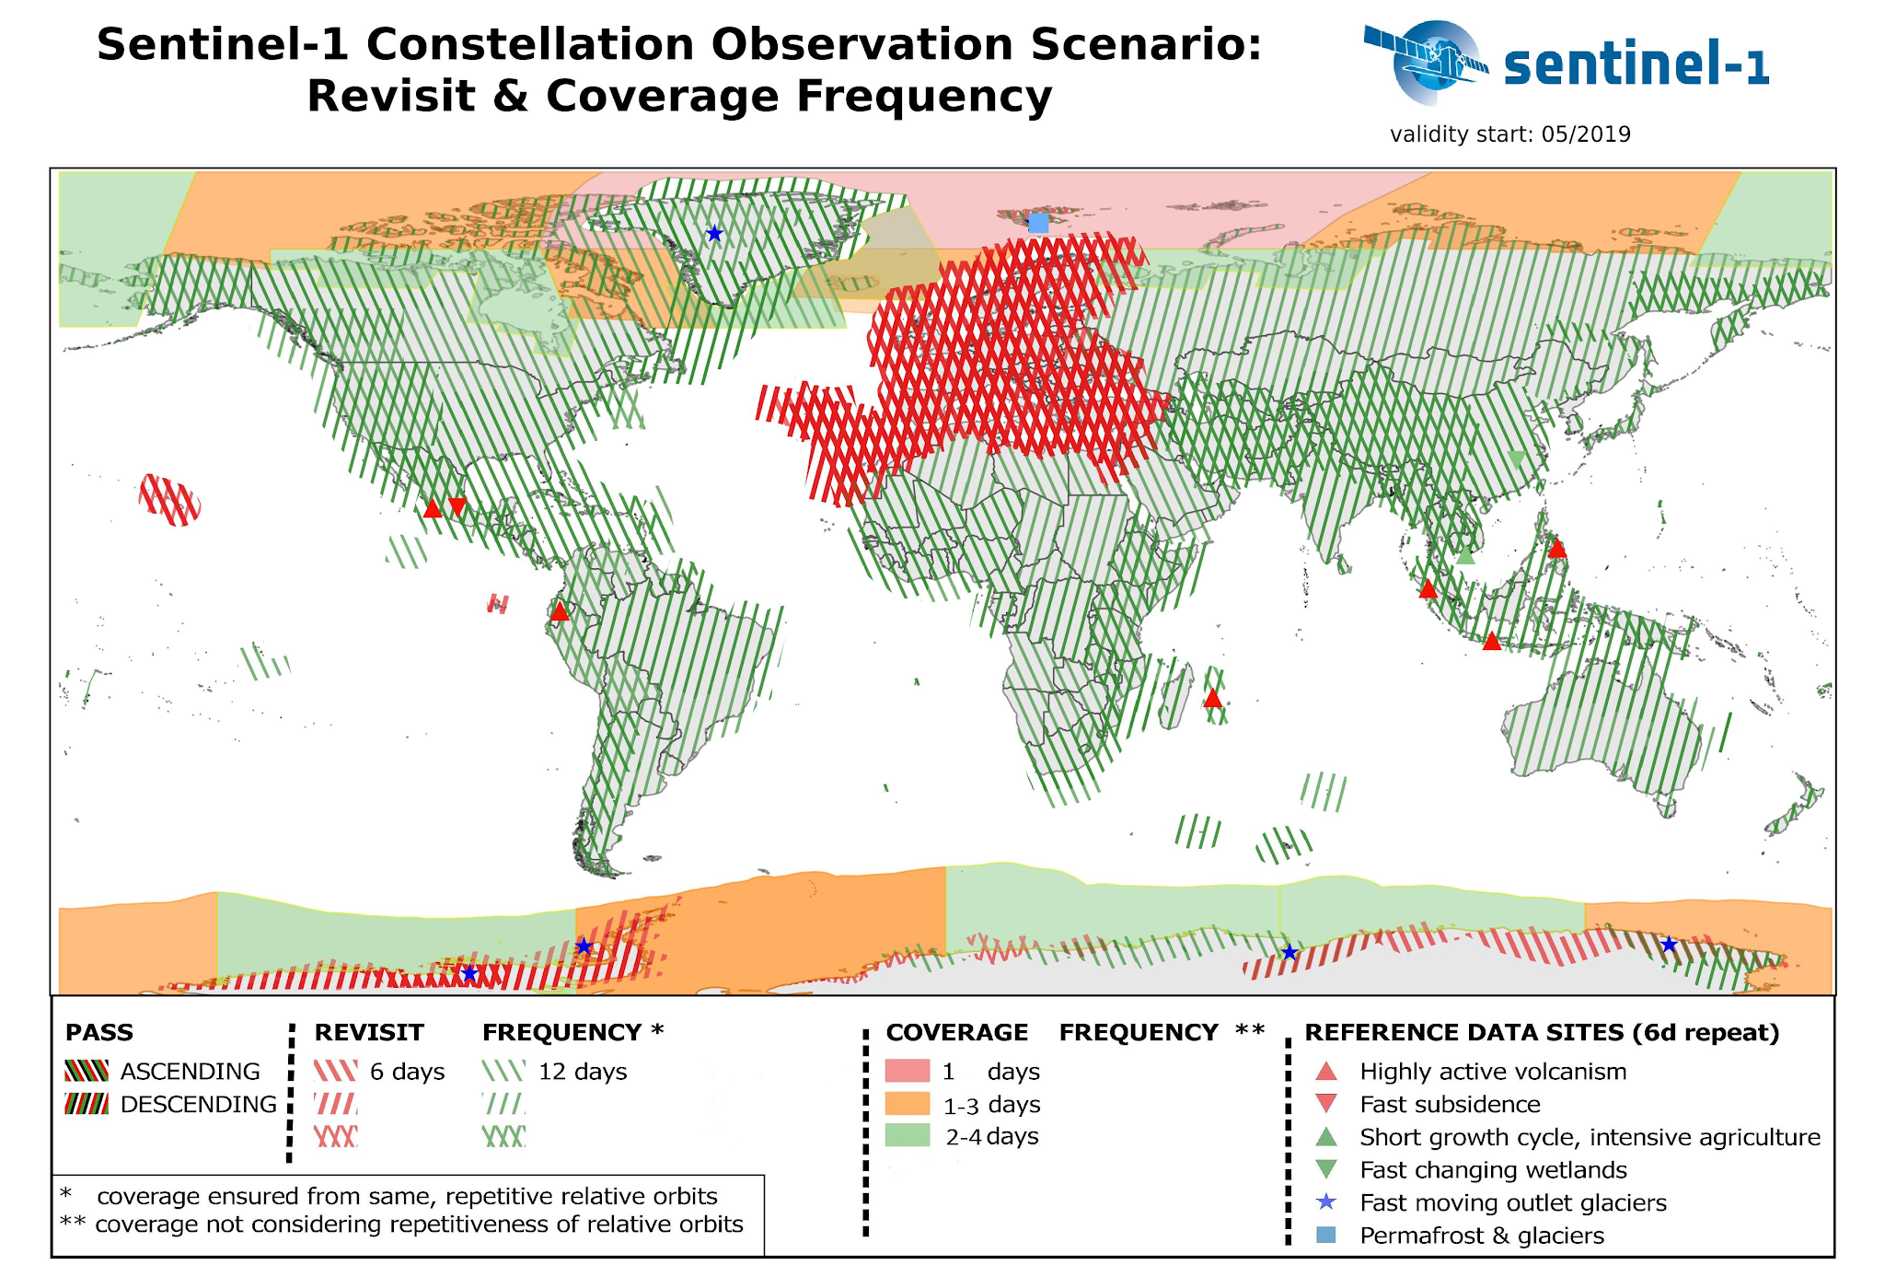
Solution Details

Slide 12
Solution Details
MODIS satellite data was used to identify urban and crop land cover.
Spatial Resolution: 500m
Temporal Resolution: 365 days
Sensor type: Optical
Bands: 36
Additionally, two datasets based on Landsat were utilized to improve the flood mapping:
Global Surface Water Dataset for Joint Research Center (JRC) for European Union
HydroSHEDS: a digital elevation model created by WWF
Flood Mapping approach recommended by the UN-Spider was followed.

Slide 13
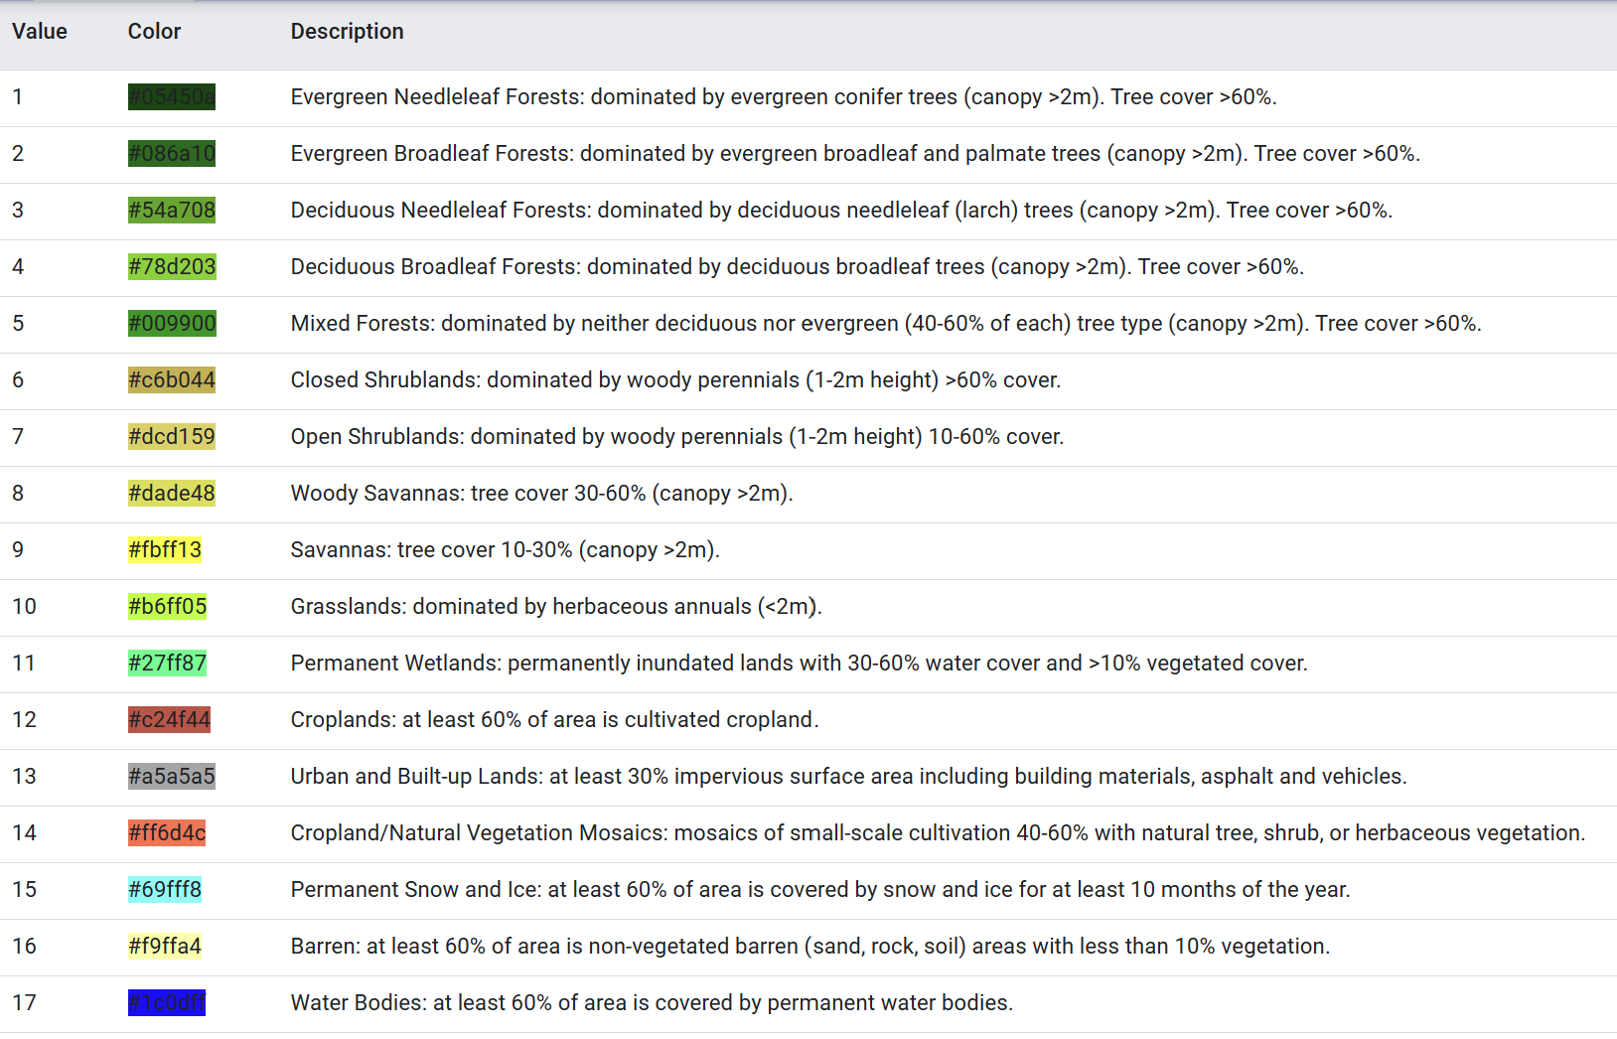
Solution Details
MODIS satellite data was used to identify urban and crop land over.
Spatial Resolution: 500m
Temporal Resolution: 365 days
Sensor type: Optical
Bands: 36

Slide 14
Solution Details
MODIS satellite data was used to identify urban and crop land over.
Spatial Resolution: 500m
Temporal Resolution: 365 days
Sensor type: Optical
Bands: 36
Additionally, two datasets based on Landsat were utilized to improve the flood mapping:
Global Surface Water Dataset for Joint Research Center (JRC) for European Union
HydroSHEDS: a digital elevation model created by WWF
Flood Mapping approach recommended by the UN-Spider was followed.

Slide 15
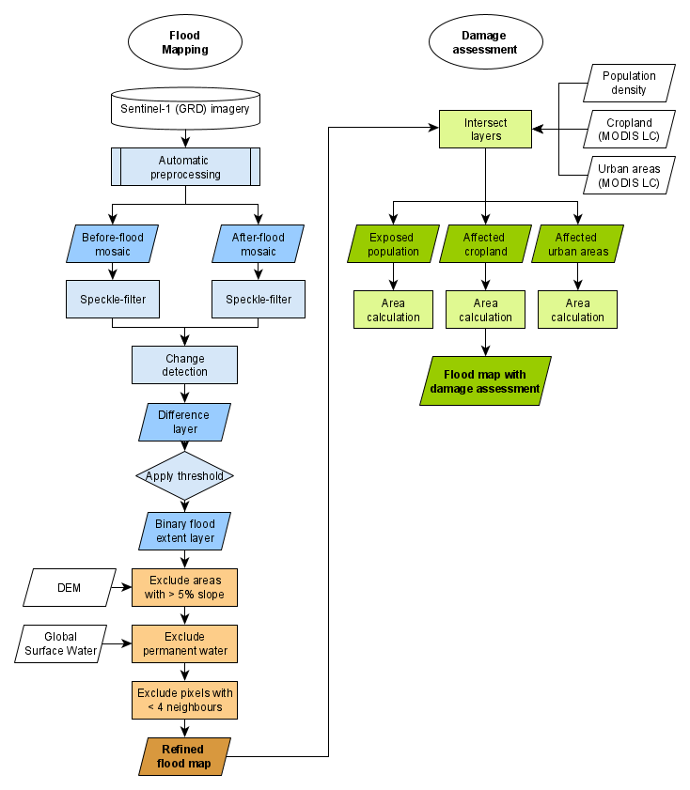
Solution Details
MODIS satellite data was used to identify urban and crop land over.
Spatial Resolution: 500m
Temporal Resolution: 365 days
Sensor type: Optical
Bands: 36
Additionally, two datasets based on Landsat were utilized to improve the flood mapping:
Global Surface Water Dataset for Joint Research Center (JRC) for European Union
HydroSHEDS: a digital elevation model created by WWF
Flood Mapping approach recommended by the UN-Spider was followed.

Slide 16
Solution Details
MODIS satellite data was used to identify urban and crop land over.
Spatial Resolution: 500m
Temporal Resolution: 365 days
Sensor type: Optical
Bands: 36
Additionally, two datasets based on Landsat were utilized to improve the flood mapping:
Global Surface Water Dataset for Joint Research Center (JRC) for European Union
HydroSHEDS: a digital elevation model created by WWF
Flood Mapping approach recommended by the UN-Spider was followed.

Slide 17
Solution Results
Highlights:
The solution performs well and is able to capture the extent of the flood events to a fair degree of visual accuracy and has the necessary measures as recommend by UN-Spider to ensure robustness of results.
The concept application is easy to use for non-technical users and can be used to provide a quick and rough impact assessment of flooding events from the past and the future.
Challenges & Future Work:
Intercepting and Masking Data from different
Getting asynchronously generated statistics display on UI.
Adding support for additional parameters to be directly modified by the user at the interface.
Testing of application for edge cases.

Slide 18
Solution Results
References:
UN-SPIDER Best Practices for Flood Mapping using Google Earth Engine and original Earth Engine Script.
Detecting Changes in Sentinel-1 Imagery - Tutorial Google Earth Engine
Sentinel Hub. (n.d.). Sentinel-1 GRD data. Retrieved from https://docs.sentinel-hub.com/api/latest/data/sentinel-1-grd/
Wikipedia contributors. (2022). 2022 Pakistan floods [Photograph]. Retrieved from https://en.wikipedia.org/wiki/2022_Pakistan_floods#/media/File:2022_Pakistan_Floods_-_August_27,_2021_vs._August_27,_2022_in_Sindh.jpg
UN-SPIDER. (n.d.). Recommended practice: Google Earth Engine flood mapping. UN-SPIDER. https://un-spider.org/advisory-support/recommended-practices/recommended-practice-google-earth-engine-flood-mapping/in-detail

Slide 19

GO DEVILS!

